Slide 1
GOVT. COLLEGE ROPAR
DEPARTMENT OF ECONOMICS
TOPIC-:MEASURES OF CENTRAL TENDENCY
MEANING OF CENTRAL TENDENCY.
MEASURES OF CENTRAL TENDENCY.
TYPE OF CENTRAL TENDENCY.
CLASS – B.A SEM 6
PRO.RITU

Slide 2
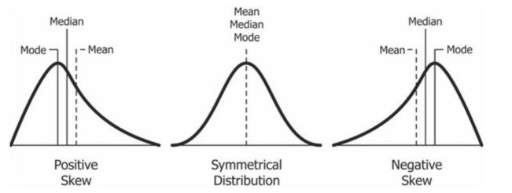
INTRODUCTION-:A measure of central tendency is a single value that attempts to describe a set of data by identifying the central position within that set of data. As such, measures of central tendency are sometimes called measures of central location.

Slide 3
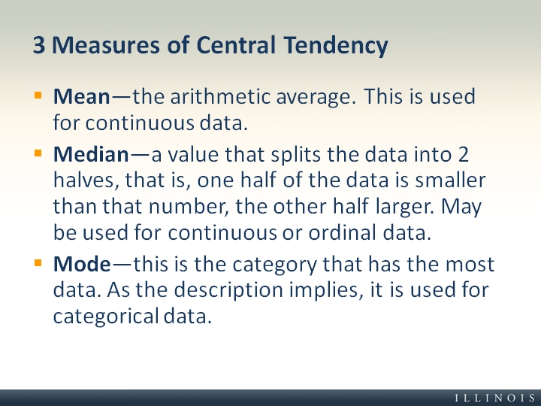
MEASURES OF CENTRAL TENDENCY-:Measures of central tendency are numbers that tend to cluster around the “middle” of a set of values. Three such middle numbers are the mean, the median, and the mode

Slide 4
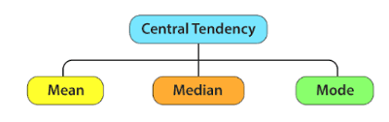
TYPE OF CENTRAL TENDENCY-:There are three main measures of central tendency: the mode, the median and the mean.

Slide 5
MEAN-: The "average" number; found by adding all data points and dividing by the number of data points.
1.INDIVIDUAL SERIES-:
DIRECT METHOD- X̄= ∑X/N.
SHORT CUT METHOD- X̄= ∑d/N.
2.DISCRETE SERIES-:
DIRECT METHOD- X̄= ∑fx/ ∑f.
SHORT CUT METHOD- X̄= A+∑fd/∑f.
STEP DEVIASION METHOD- X̄= A+ ∑fd’/ ∑f*c
3. CONTINUOUS SERIES-:
DIRECT METHOD- X̄= ∑fm/ ∑f.
SHORT CUT METHOD- X̄=A+ ∑fd/ ∑f.

Slide 6
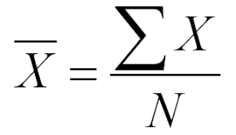
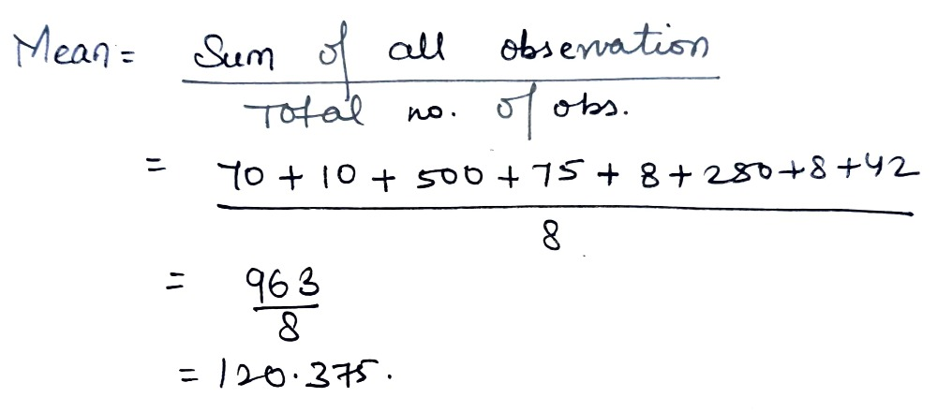
EXAMPLE HOW TO SOLVE MEAN

Slide 7
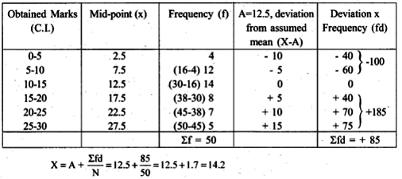
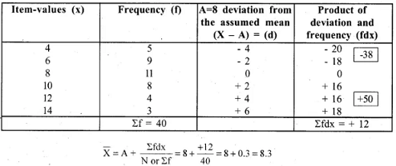
SOLVING MEAN WITH SHORT CUT METHOD

Slide 8
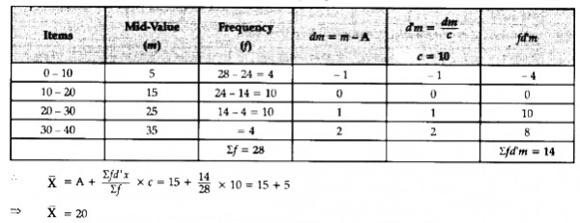
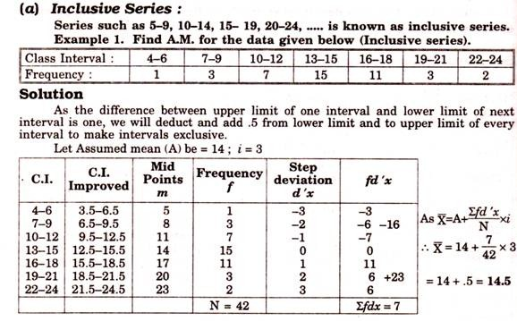
Solving mean with step deviation-:

Slide 9
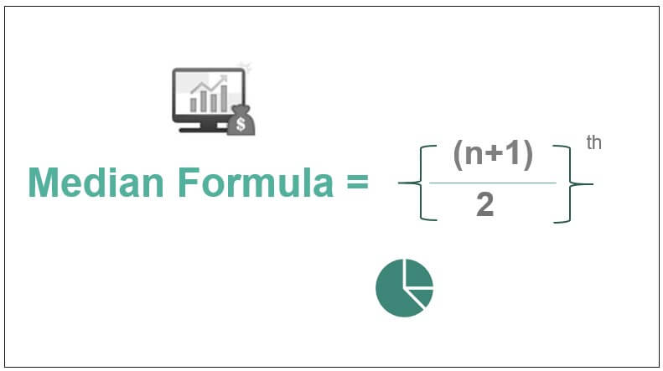

MEDIAN-:The median is the middle number in a sorted, ascending or descending, list of numbers and can be more descriptive of that data set than the average
MEDIAN -:
M=size of (n+1/2) th item
CONTINUOUS METHOD-:

Slide 10
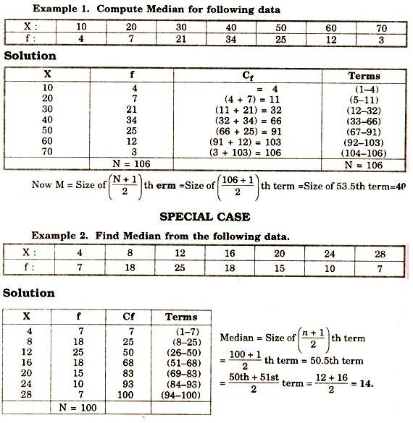
EXAMPLE OF MEDIAN-:
SIMPLE METHOD-:

Slide 11
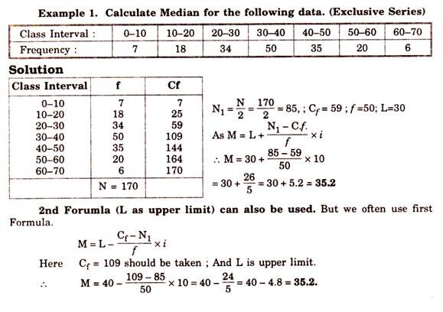
SOLVING MEDIAN IN CONTINUOUS SERIES-:

Slide 12
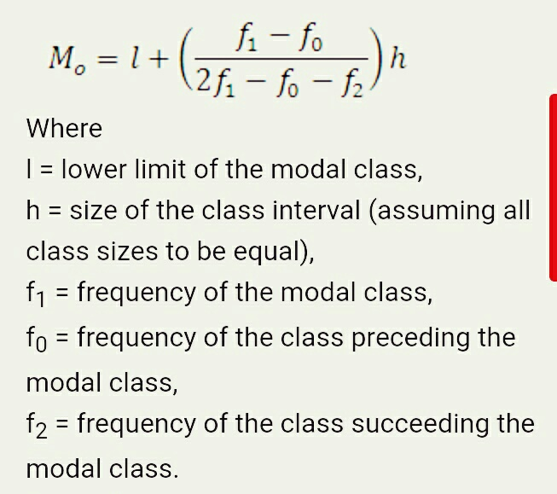
MODE-: The mode is the value that appears most often in a set of data values.
MODE(Z)

Slide 13
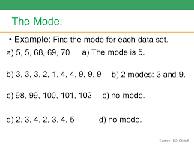
EXAMPLE OF MODE(Z)-:

Slide 14
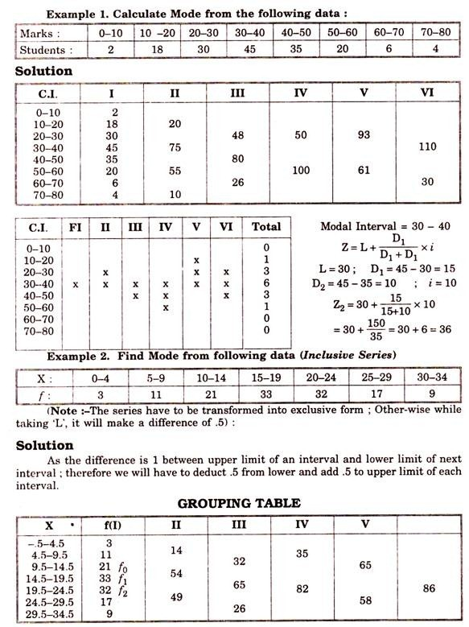
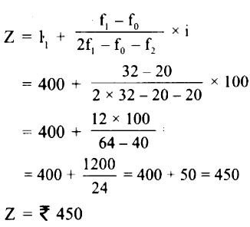
SOLVING MODE IN CONTINUOUS SERIES-:

Slide 15
THANK YOU

